Slide 1

Global Radiation Prediction Model (U.G. Project)
Submitted by:
Mr. Pranav Dev
20124037
Mathematics and Computing
Under the guidance of:
Dr. S.K. Pandey

Slide 2
CONTENTS
Overview of the Project
About Neural Networks
Loss functions
Sequence Models
Recurrent Neural Network (RNN)
Gated Recurrent Unit (GRU)
Long Short Term Memory (LSTM)
Time Series Forecasting
Analysing the data
Creating Training data
Creating the model
Results on Testing data
Improvements and Future Scope
Conclusion
References

Slide 3
OVERVIEW OF THE PROJECT
Time series forecasting is the process of analyzing time series data using statistics and modeling to make predictions and inform strategic decision-making.
Solar energy is the radiant light and heat from that the Sun, and can be harnessed using a range of technologies. Predicting the attributes associated with the solar radiation has become an important element in the production of solar energy these days.
In this machine learning model, I will predict the different global radiation parameters such as Clearsky DHI, Clearsky DNI, and Clearsky GHI.

Slide 4
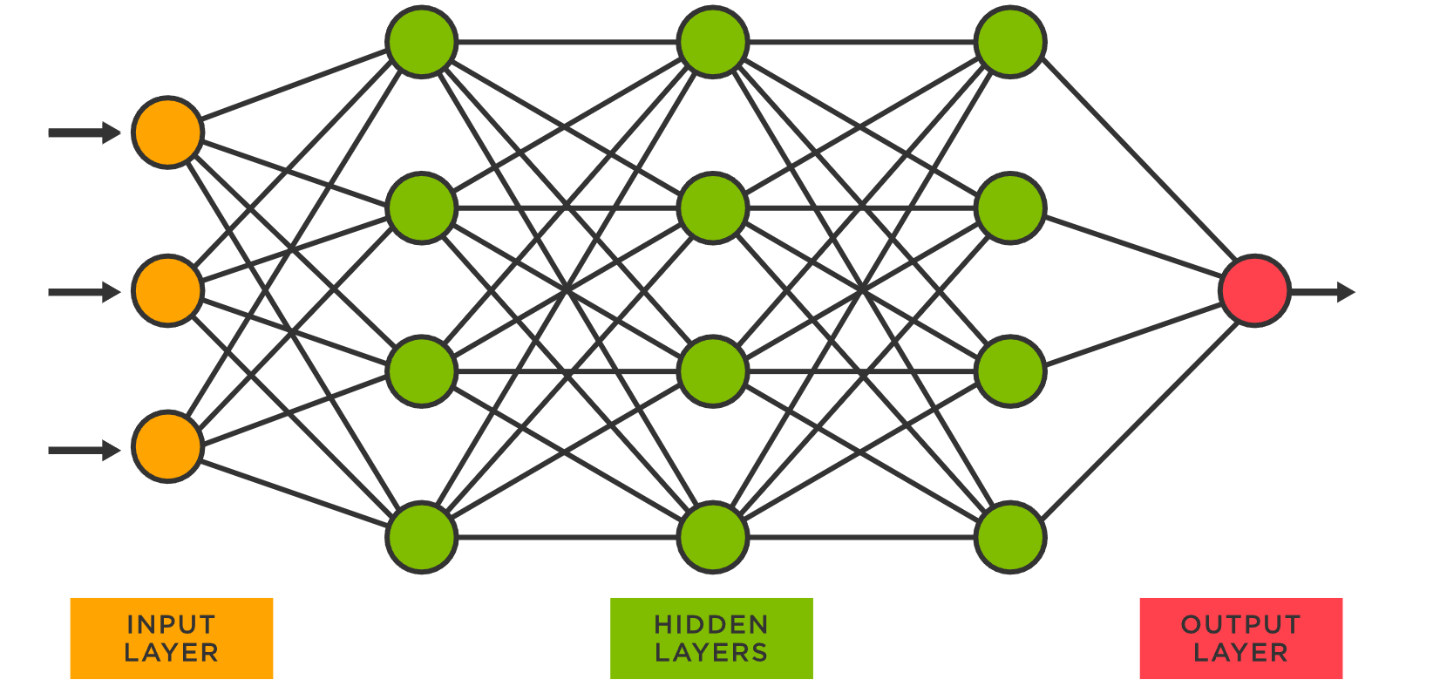
ABOUT NEURAL NETWORKS
A neural network contains layers of interconnected nodes. Each node is a known as perceptron and is similar to a multiple linear regression. The perceptron feeds the signal produced by a multiple linear regression into an activation function that may be nonlinear.

Slide 5
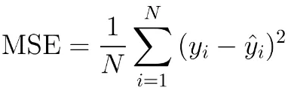

LOSS FUNCTIONS
In machine learning, a loss function is a measure of how accurately a model is able to predict the expected outcome in other words, the ground truth.
The few of the most common loss functions are:
Mean Squared Error (MSE):
Mean Absolute Error (MAE):

Slide 6
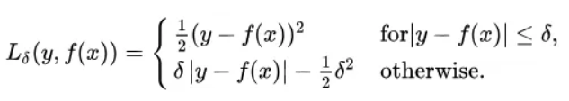
LOSS FUNCTIONS
Huber Loss: The MSE is great for learning outliers while the MAE is great for ignoring them, the Huber loss provides a balance to both the errors.
The huber loss is defined using the following piecewise function:
When the loss values are greater than 1, they are magnified, else the quadratic function is used to down-weights them to focus the training on the higher-error data points.

Slide 7
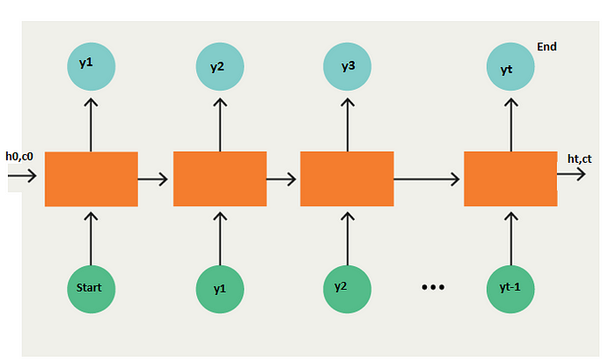
SEQUENCE MODELS
Sequence models are machine learning models that input or output sequences of data. Sequential data includes time-series data, text streams, audio clips, etc.
The sequence models can be implemented using:
RNNs
GRUs
LSTMs

Slide 8
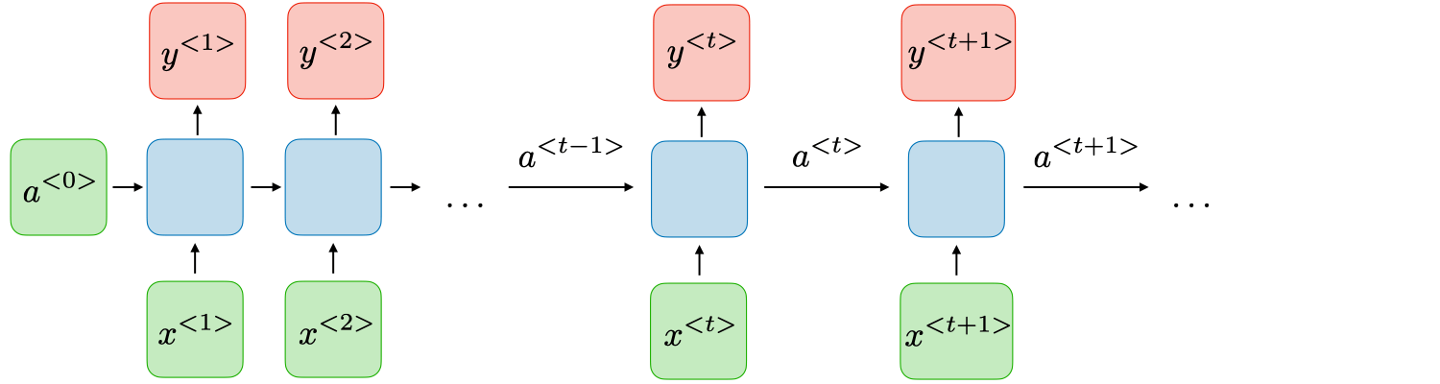
RECURRENT NEURAL NETWORKS (RNN)
Recurrent neural networks works on the recurrence principle, in which the internal state at a given time step is dependent on the internal step at the previous time step and the sequence we are working on.

Slide 9
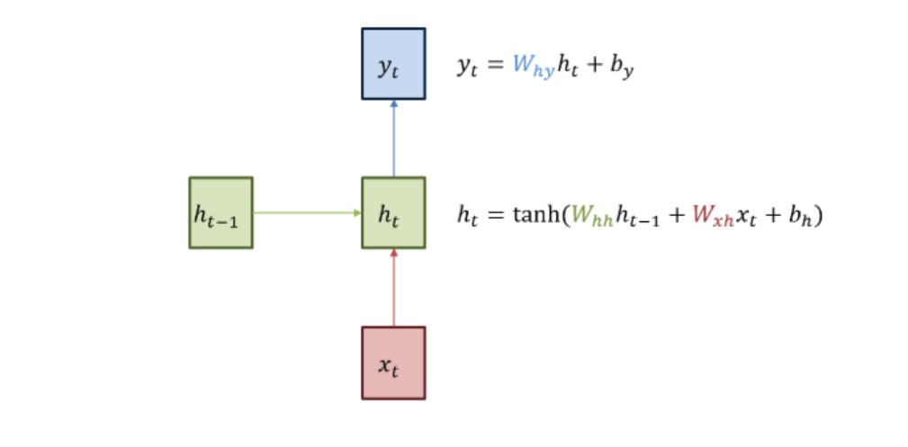
RECURRENT NEURAL NETWORKS (RNN)
With the help of recurrence property, RNNs are able to have a short-term memory which allows them to store previous information.
One of the drawbacks of RNNs are that they are not able to handle long-term dependencies, and problems such as vanishing gradients, or exploding gradients may occur.

Slide 10
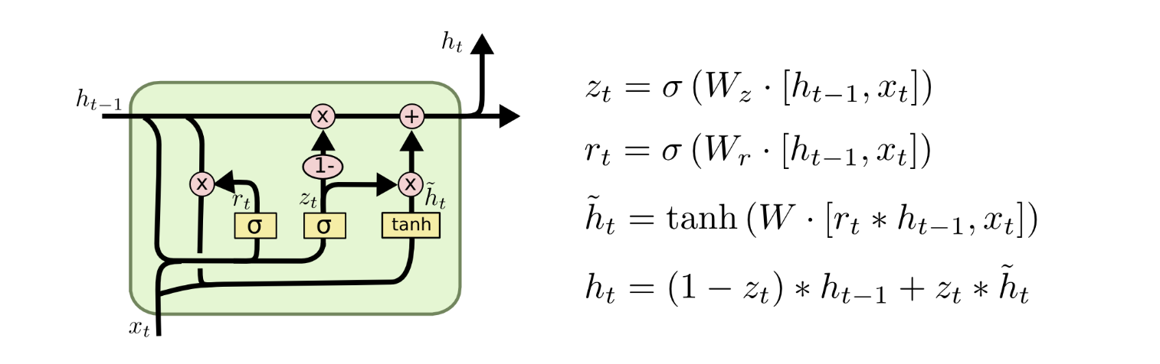
GATED RECURRENT UNIT (GRU)
Gated Recurrent Unit uses so-called update gate, and reset gate, two vectors to decide how much of the past information (from previous time series) should be passed on to the output.
The vanishing gradient problem is eliminated as the model avoids washing out the new input every single time, keeps the relevant information and passes it down to the next time steps of the network.

Slide 11
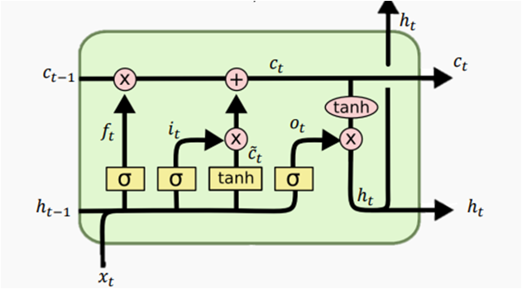
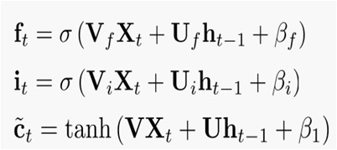
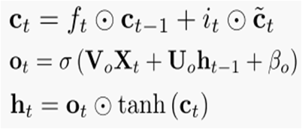
LONG SHORT TERM MEMORY (LSTM)
Long short term memory are capable of learning long-term dependencies.
LSTMs uses three gates, namely the forget gate, the input gate and the output gate to filter out what are the relevant informations which need to be used to process the current time step.

Slide 12
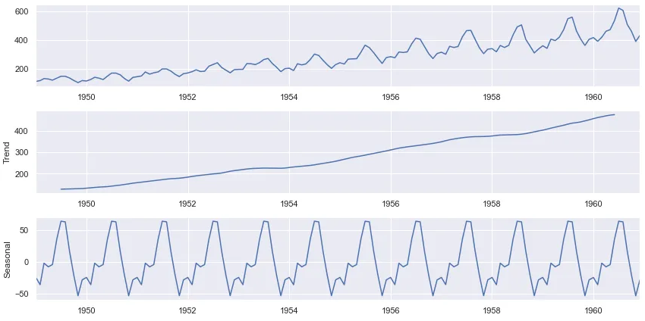
TIME SERIES FORECASTING
Seasonality: distinct periods of time when the data contains consistent irregularities.
Trends: they indicate whether a variable in the time series will increase or decrease in a given period.
Stationarity: a time series, whose statistical properties do not change over time. In other words, it has constant mean and variance.
Notes:
Autocorrelation, the similarity between observations as a function of the time lag between them.

Slide 13
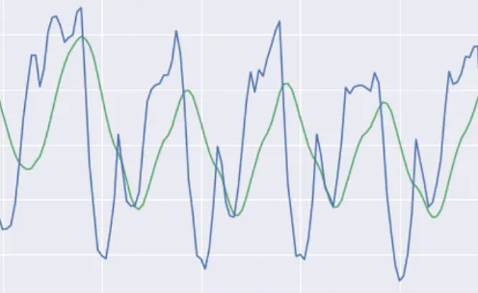
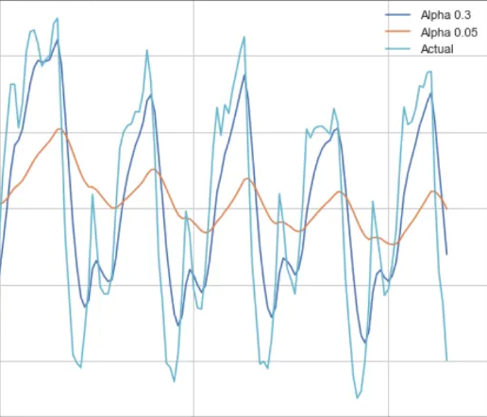
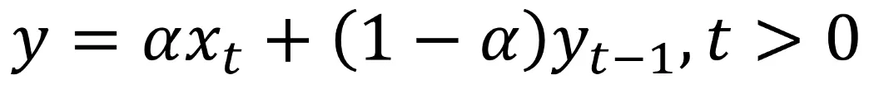
MODELLING A TIME SERIES
Moving average: the next observation is the mean of all past observations.
Exponential smoothing: a different decreasing weight is assigned to each observation.

Slide 14
USING LSTM FOR TIME SERIES FORECASTING
In this neural network model, Long Short Term Memory(LSTMs) layers are used as the Recurrent Neural Network(RNNs) layers.
For time series forecasting, to predict the parameter values of a specific time, the previous 400 entries are used.
To train the model faster, the prediction is done in batches of size 512, whereas 100 epochs are also used for better accuracy of the training model.

Slide 15
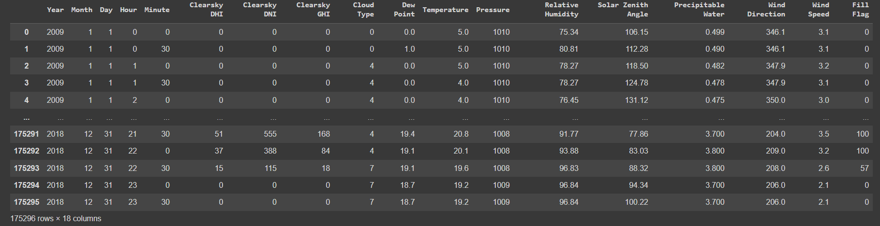
ANALYZING THE DATA
The parameters on which the data will be trained.

Slide 16
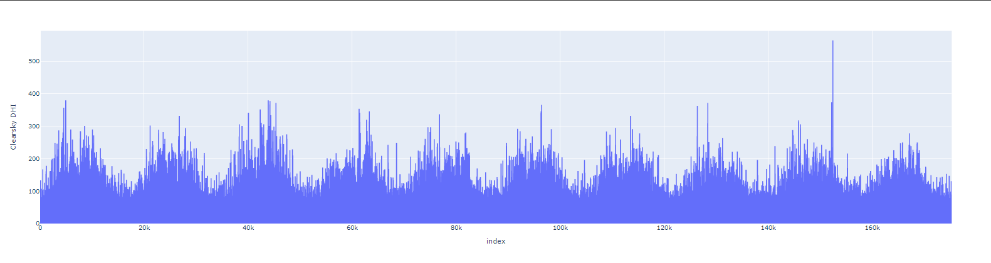
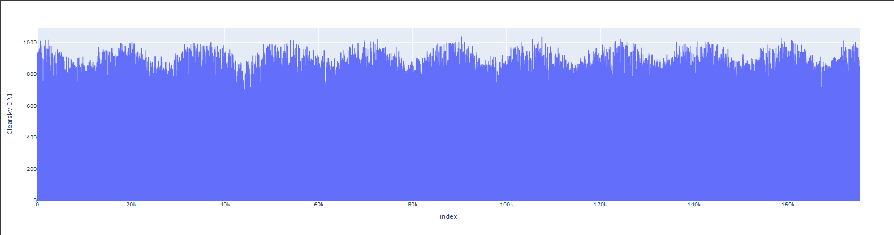
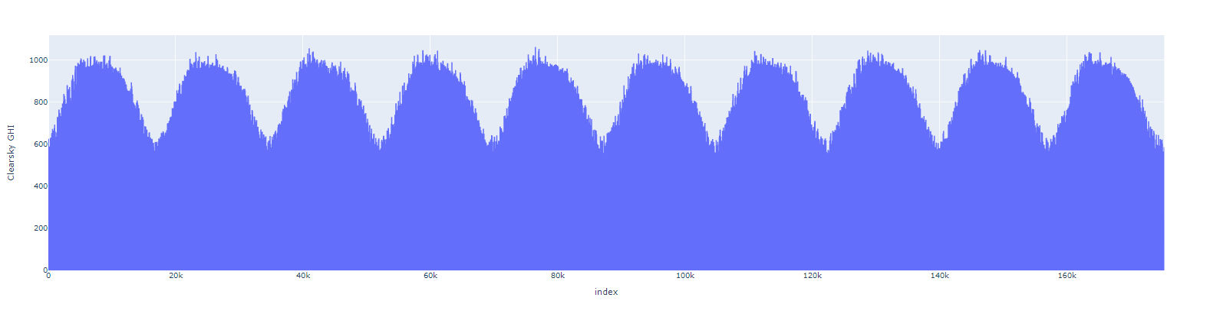
VISUAL REPRESENTATION OF PARAMETERS
Clearsky DHI
Clearsky DNI
Clearsky GHI

Slide 17


CREATING TRAINING DATA
Using LSTM to train the data
Normalizing the data, for faster training and better accuracy.

Slide 18
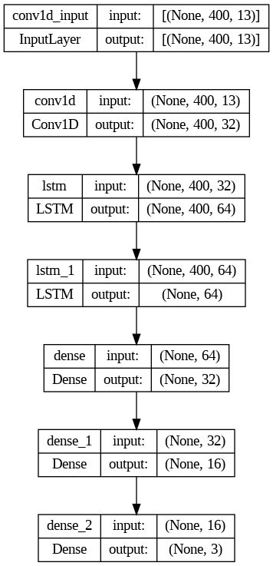
LAYERS OVERVIEW

Slide 19
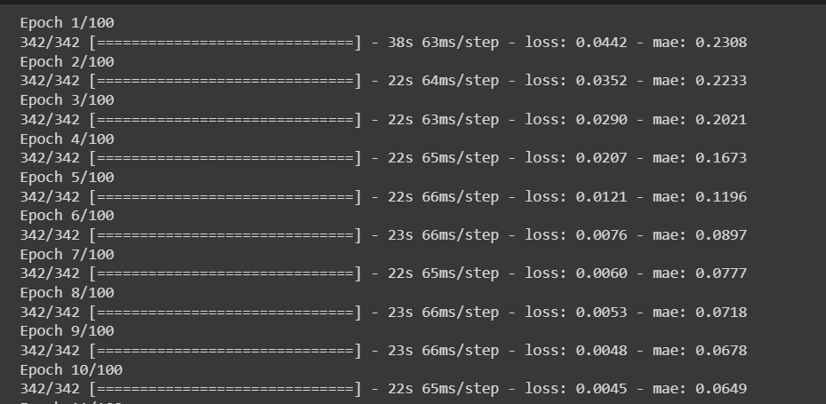
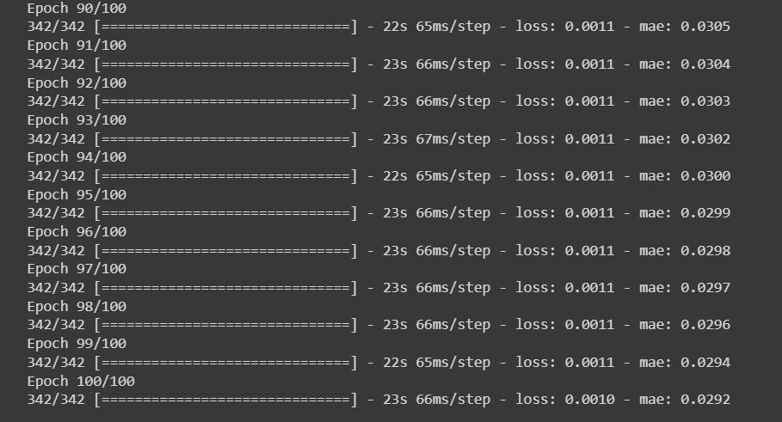
TRAINING RESULTS
At the start of training
At the end of training

Slide 20
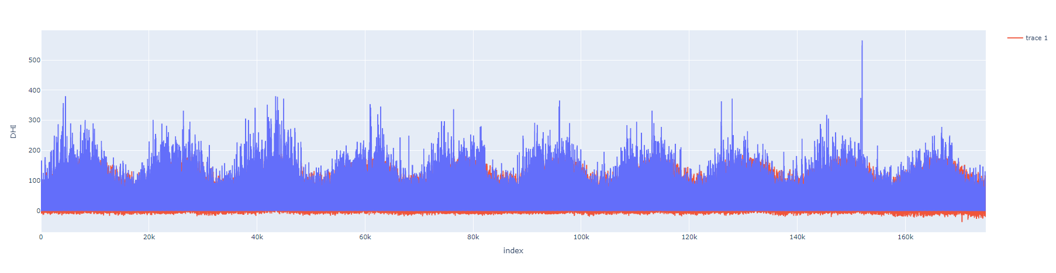
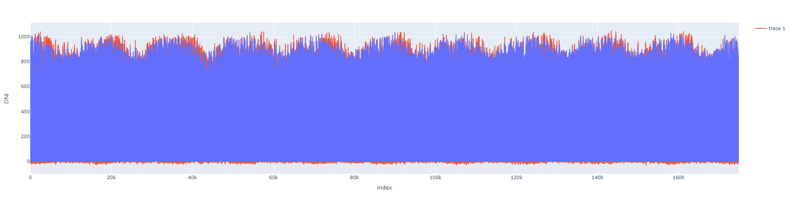
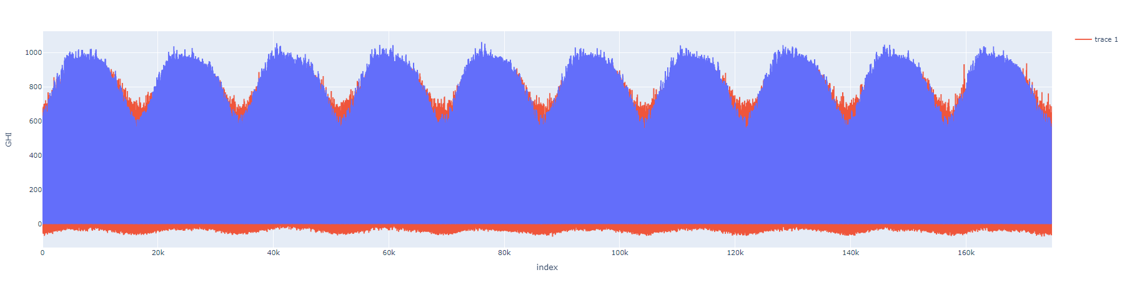
TRAINING RESULTS
Predicted clearsky DHI
Predicted clearsky DNI
Predicted clearsky GHI

Slide 21
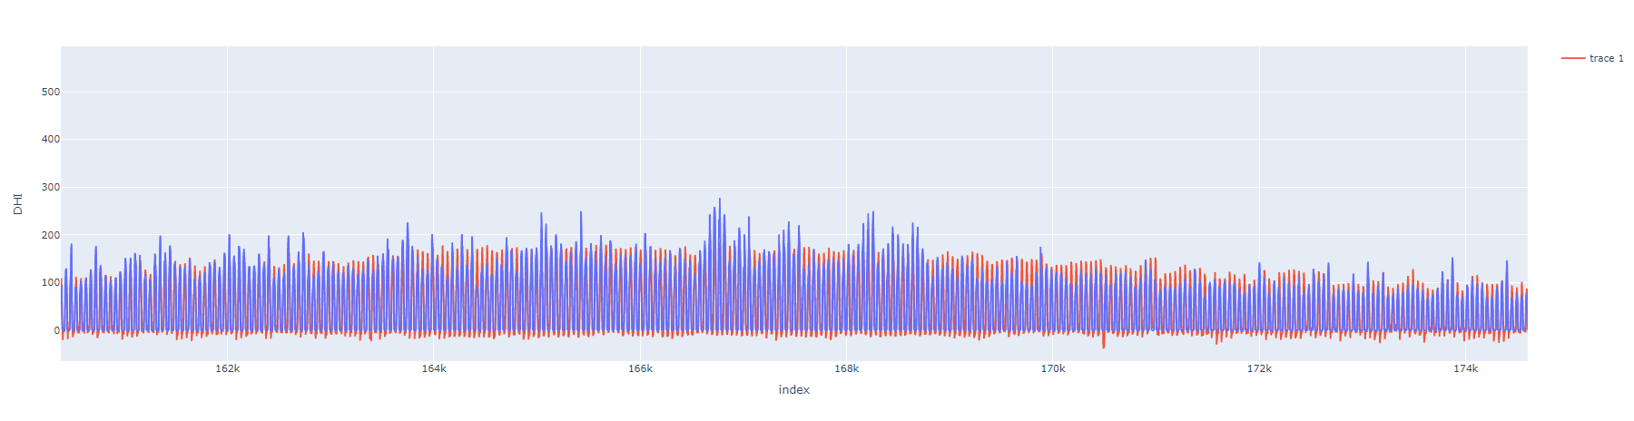
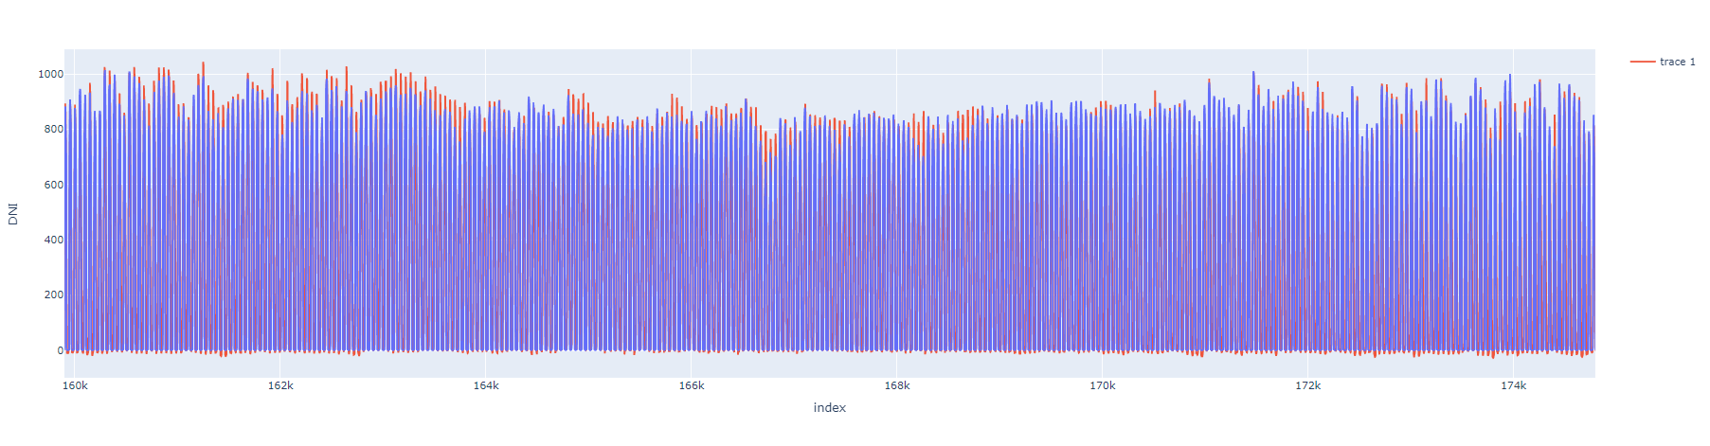
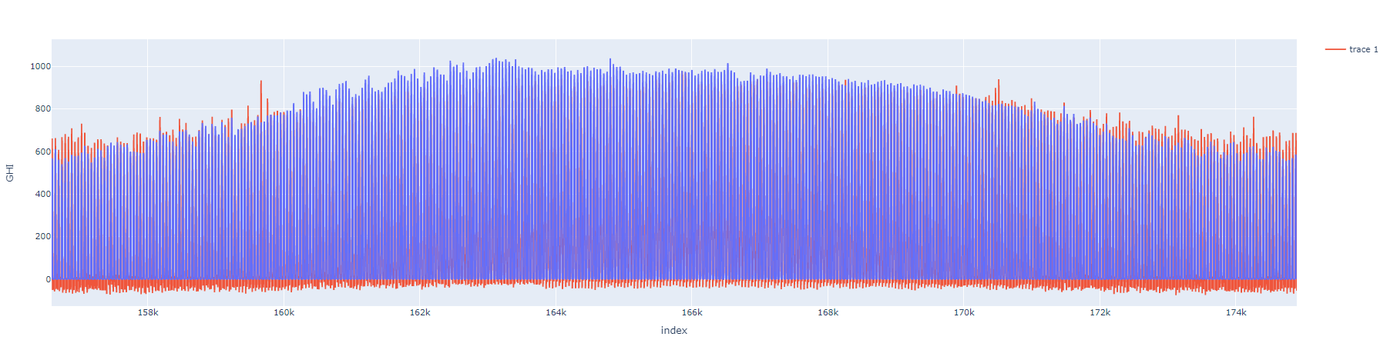
RESULTS ON TEST DATA
Predicted clearsky DHI
Predicted clearsky DNI
Predicted clearsky GHI

Slide 22
CONCLUSION
In building this project, neural networks with loss functions as mean absolute error and huber loss were used to calculate the accuracy of the model.
Sequence models such as Recurrent Neural Network(RNN), Long Short Term Memory(LSTM) were implemented with the help of the tensorflow library, and multivariate time series forecasting was applied on the same to predict the parameters.
Huber loss of 0.0012 and mean absolute error of 0.0314 was obtained, which reflects the accuracy of the model.

Slide 23
SCOPE OF IMPROVEMENT
Different regularization methods like L2 regularization, dropout regularization, early stopping can be implemented to check if these help in improving the accuracy of the model.
Different optimization techniques such as better normalization of inputs can be tried to check the further improvement in the accuracy of the model.
Different modeling techniques such as AutoRegressive Integrated Moving Average(ARIMA), Seasonal AutoRegressive Integrated Moving Average(SARIMA) can be used to model the time series forecasting.

Slide 24
REFERENCES
The following resources were referred while completing the project:
Deep Learning Specialization by Andrew Ng at coursera.org
Understanding LSTM Networks by colah’s blog
Empirical Evaluation of Gated Recurrent Neural Networks on Sequence Modeling by Junyoung Chung
The Complete Guide to Time Series Analysis and Forecasting by Rian Dolphin
Time Series Analysis and Forecasting by Marco Peixeiro
MachineHack for providing the dataset

